Slide 1
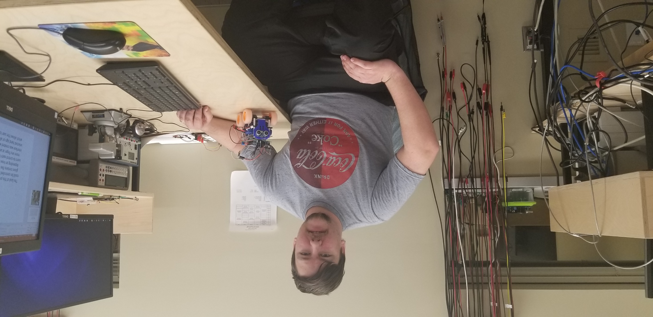

Slide 2
Dual Event Monitoring Obstacle Navigator (D.E.M.O.N Bot)
My third year project was to design and program a wireless remote controlled vehicle. Using the graphical user interface, the user can control the robots’ direction and ability to maneuver around obstacles. Assembled together with an Arduino UNO microcontroller, a WiFi chip, and a custom made PCB, this design came from conception to reality in the span of two semesters.
By Patrick Bellemare

